Slide 1
Mathematical Economics
Lecture 6

Slide 2
Plan
Complete metric spaces
Cauchy sequences
Contractions and fixed points
Contraction mapping theorem
Continuous dependence of the fixed point on parameters
Blackwell’s sufficient conditions

Slide 3
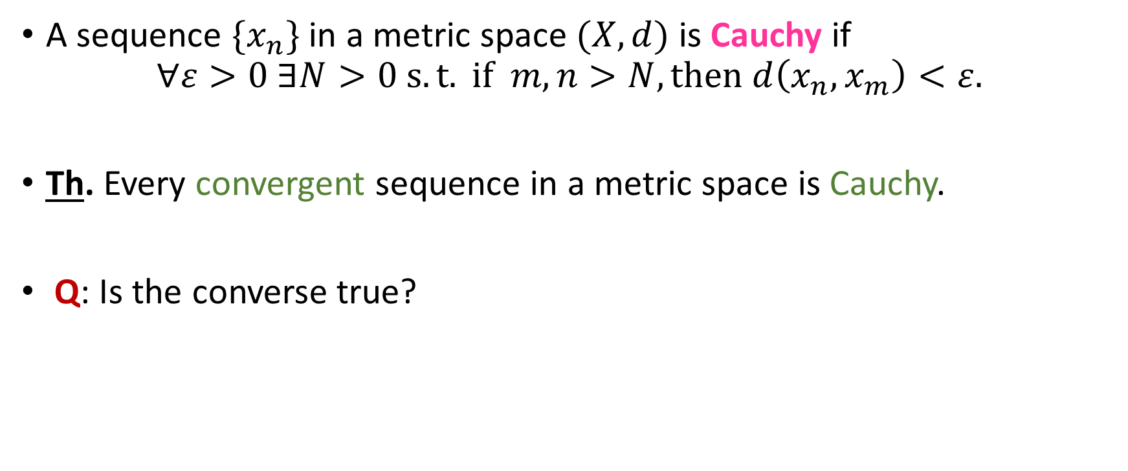
Cauchy sequence
A sequence $\{x_{n}\}$ in a metric space $(X,d)$ is Cauchy if
$$∀ε>0 ∃N>0 s.t. if m,n>N, then d\left(x_{n},x_{m}\right)<ε.$$
Th. Every convergent sequence in a metric space is Cauchy.
Q: Is the converse true?

Slide 4
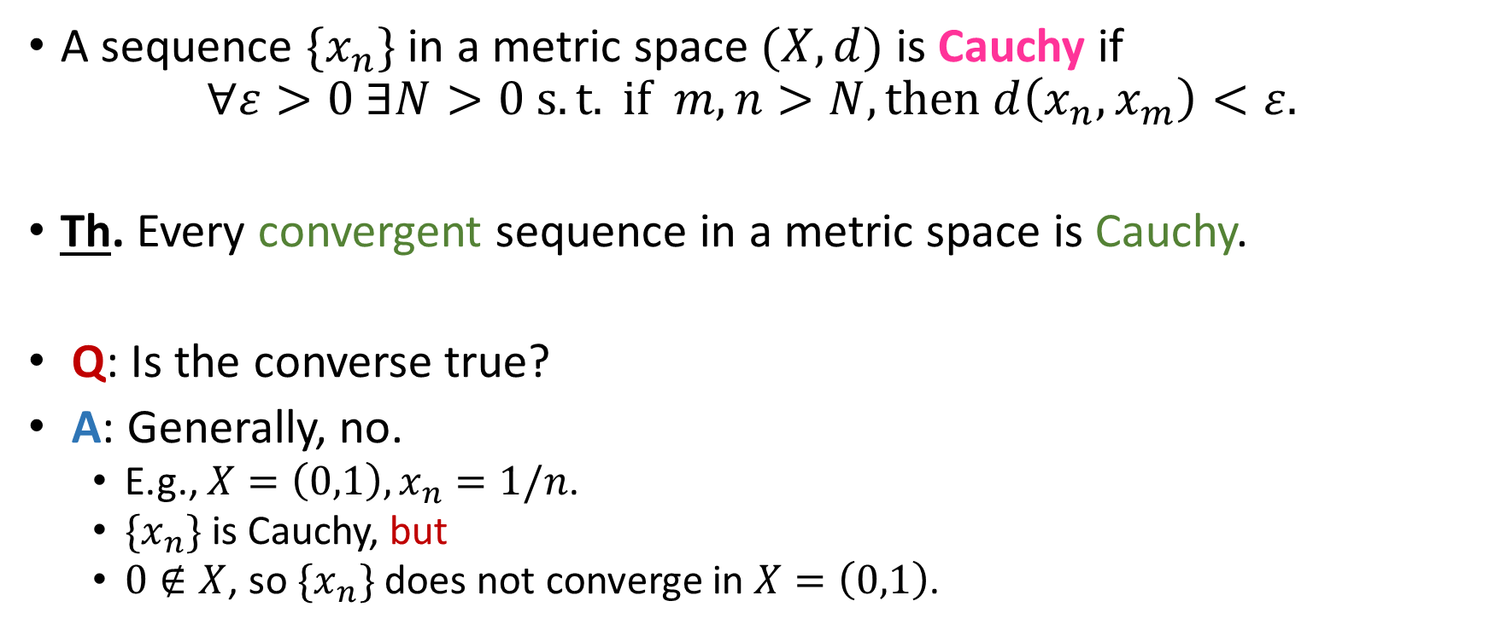
Cauchy sequence
A sequence $\{x_{n}\}$ in a metric space $(X,d)$ is Cauchy if
$$∀ε>0 ∃N>0 s.t. if m,n>N, then d\left(x_{n},x_{m}\right)<ε.$$
Th. Every convergent sequence in a metric space is Cauchy.
Q: Is the converse true?
A: Generally, no.
E.g., $X=\left(0,1\right),x_{n}=1/n$.
$\{x_{n}\}$ is Cauchy, but
$0∉X$, so $\{x_{n}\}$ does not converge in $X=\left(0,1\right)$.

Slide 5
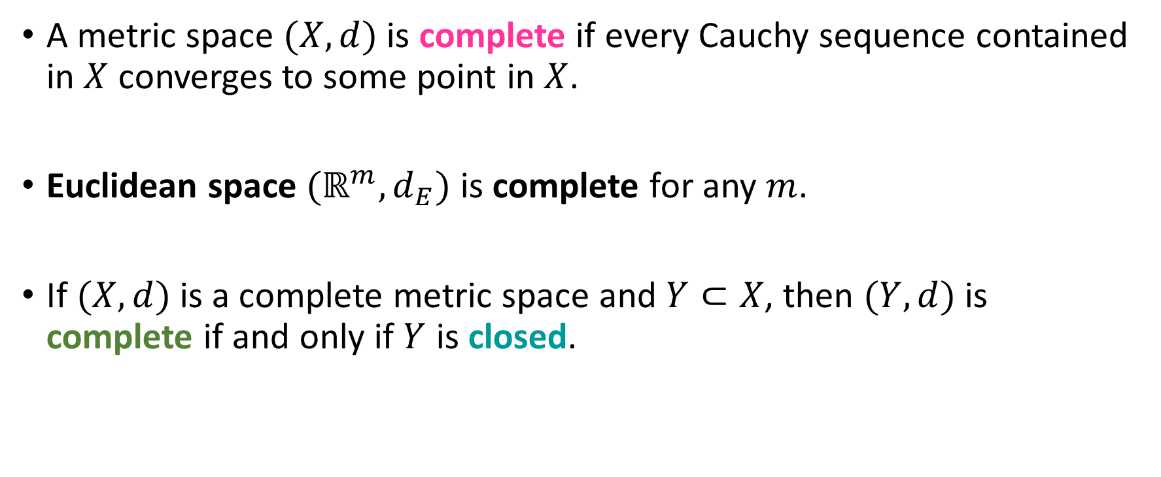
Complete Metric Spaces
A metric space $(X,d)$ is complete if every Cauchy sequence contained in $X$ converges to some point in $X$.
Euclidean space $(ℝ^{m},d_{E})$ is complete for any $m$.
If $(X,d)$ is a complete metric space and $Y⊂X$, then $(Y,d)$ is complete if and only if $Y$ is closed.

Slide 6
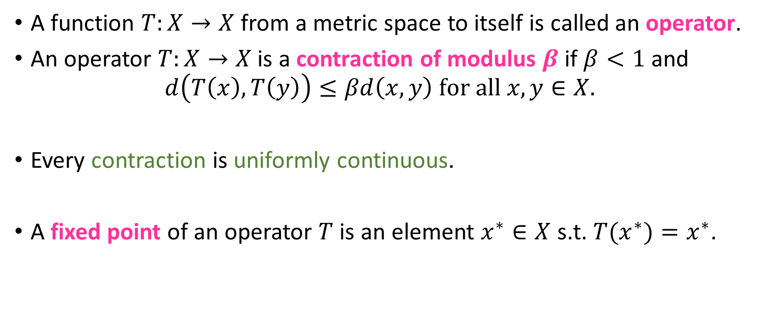
Contraction and Fixed Points
A function $T:X→X$ from a metric space to itself is called an operator.
An operator $T:X→X$ is a contraction of modulus $β$if $β<1$ and
$$d\left(T\left(x\right),T\left(y\right)\right)≤βd\left(x,y\right) for all x,y∈X.$$
Every contraction is uniformly continuous.
A fixed point of an operator $T$ is an element $x^{∗}∈X$ s.t. ${T(x}^{∗})=x^{∗}$.

Slide 7
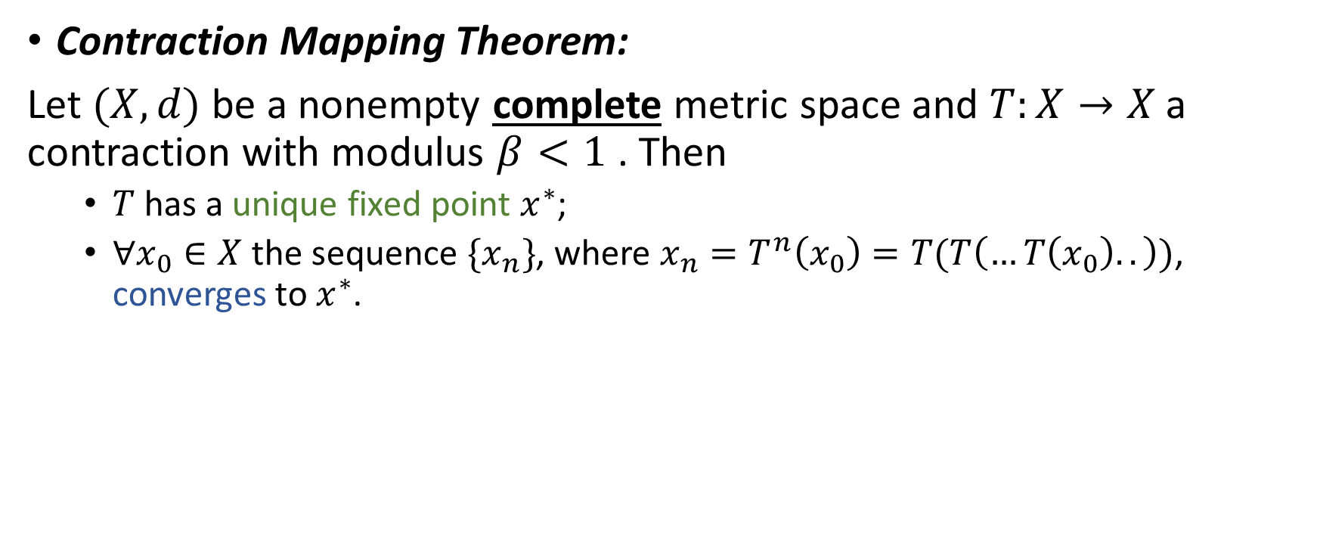
Contraction Mapping Theorem
Contraction Mapping Theorem:
Let $(X,d)$ be a nonempty complete metric space and $T:X→X$ a contraction with modulus $β<1$ . Then
$T$ has a unique fixed point $x^{∗}$;
$∀x_{0}∈X$ the sequence $\{x_{n}\}$, where $x_{n}=T^{n}\left(x_{0}\right)=T(T\left(…T\left(x_{0}\right)..\right))$, converges to $x^{∗}$.

Slide 8
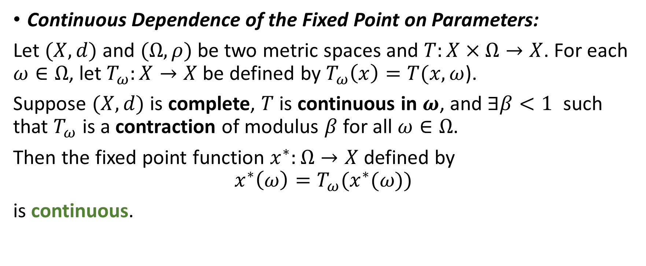
Continuous Dependence of the Fixed Point on Parameters
Continuous Dependence of the Fixed Point on Parameters:
Let $(X,d)$ and $(Ω,ρ)$ be two metric spaces and $T:X×Ω→X$. For each $ω∈Ω$, let $T_{ω}:X→X$ be defined by $T_{ω}\left(x\right)=T(x,ω$).
Suppose $(X,d)$ is complete, $T$ is continuous in $ω$, and $∃β<1$ such that $T_{ω}$ is a contraction of modulus $β$ for all $ω∈Ω$.
Then the fixed point function $x^{∗}:Ω→X$ defined by
$$x^{∗}\left(ω\right)=T_{ω}(x^{∗}(ω\text{)})$$
is continuous.

Slide 9
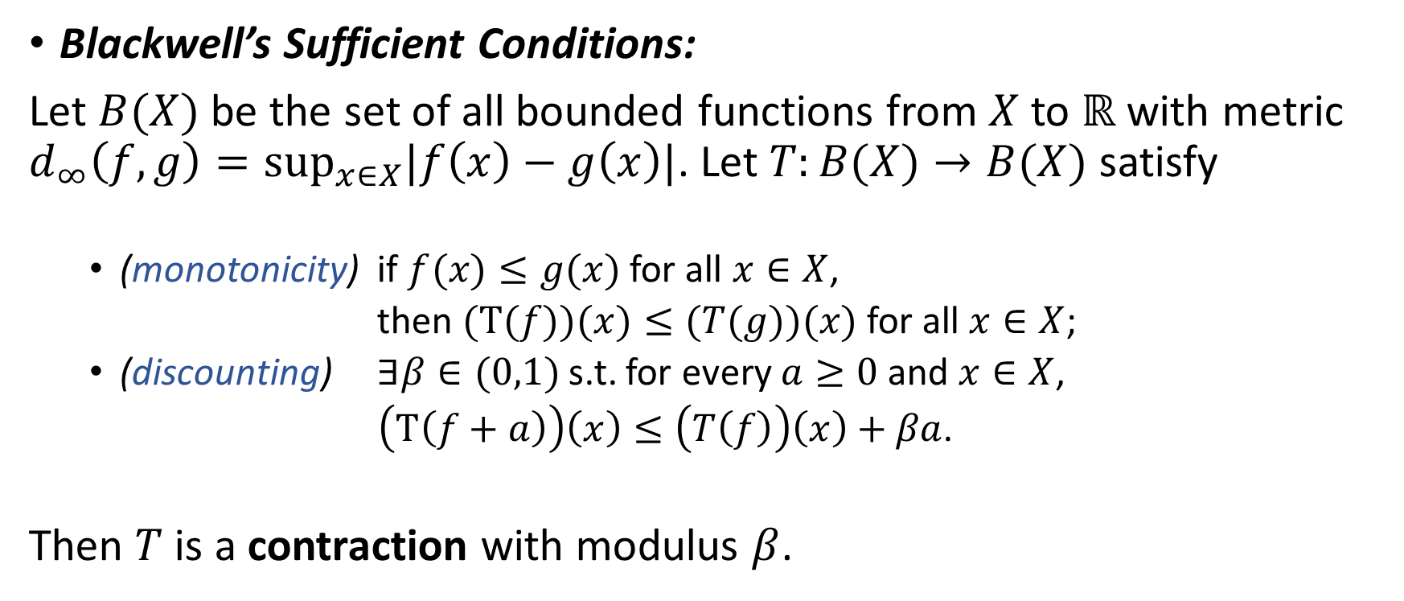
Blackwell’s Sufficient Conditions
Blackwell’s Sufficient Conditions:
Let $B(X)$ be the set of all bounded functions from $X$ to $ℝ$ with metric $d_{∞}\left(f,g\right)=\sup_{x∈X}|f\left(x\right)−g\left(x\right)|$. Let $T:B(X)→B(X)$ satisfy
(monotonicity) if $f(x)≤g(x)$ for all $x∈X$,
then $(T(f))(x)≤(T(g))(x)$ for all $x∈X$;
(discounting) $∃β∈(0,1)$ s.t. for every $a≥0$ and $x∈X$,
$\left(T\left(f+a\right)\right)\left(x\right)≤\left(T\left(f\right)\right)\left(x\right)+βa$.
Then $T$ is a contraction with modulus $β$.

